Slide 1
Kotlin – Object Orientation
Topics
· Kotlin origin
· Why kotlin?
· Java vs Kotlin
· What can kotlin do for me?
· Kotlin support architecture
2020/02/19
India SW Lab

Slide 2
Kotlin origin
Kotlin is a cross-platform, statically typed, general-purpose programming language with type inference.
In July 2011, JetBrains unveiled Project Kotlin, a new language for the JVM, which had been under development for a year
The name comes from Kotlin Island,
Kotlin v1.0 was released on 15 February 2016
At Google I/O 2017, Google announced first-class support for Kotlin on Android.
Kotlin v1.2 was released on 28 November 2017.Sharing code between JVM and JavaScript platforms feature was newly added to this release
Kotlin v1.3 was released on 29 October 2018, bringing coroutines for asynchronous programming.
On 7 May 2019, Google announced that the Kotlin programming language is now its preferred language for Android app developers.

Slide 3
Why kotlin?
Paradigm | Multi – Paradigm
Designed & Developed | Jetbrains
Typing discipline | Inferred, static, Strong
Platform | JVM, JavaScript
OS | Cross- platform
License | Apache License 2.0
FileName | .kt
Concurrent programming
Actor programming
Constraint programming
Dataflow programming
Declarative programming
Distributed programming
Functional programming
Generic programming
Imperative programming
Logic programming
Metaprogramming
Template metaprogramming
Reflective programming
Object-oriented programming
Class-based
Prototype-based
Pipeline programming
Rule-based programming
Visual programming
1) Easy setup
2) Interoperable with java
3) Boiler Plate - lots of lines of coding
4) Synthetic Extensions
5) Supports Multiple Languages
6) Null pointer exception (? & !!)
7) No semicolon's
8) Many standard Libraries
9) New Learnings
10) Lambda expressions

Slide 4










Good for…
IDE’s
Mobile – Cross Platform
IntelliJ IDEA
Native
Data Science
Android Studio
Server – Side
Eclipse
Web development
Standalone Compiler
Android

Slide 5

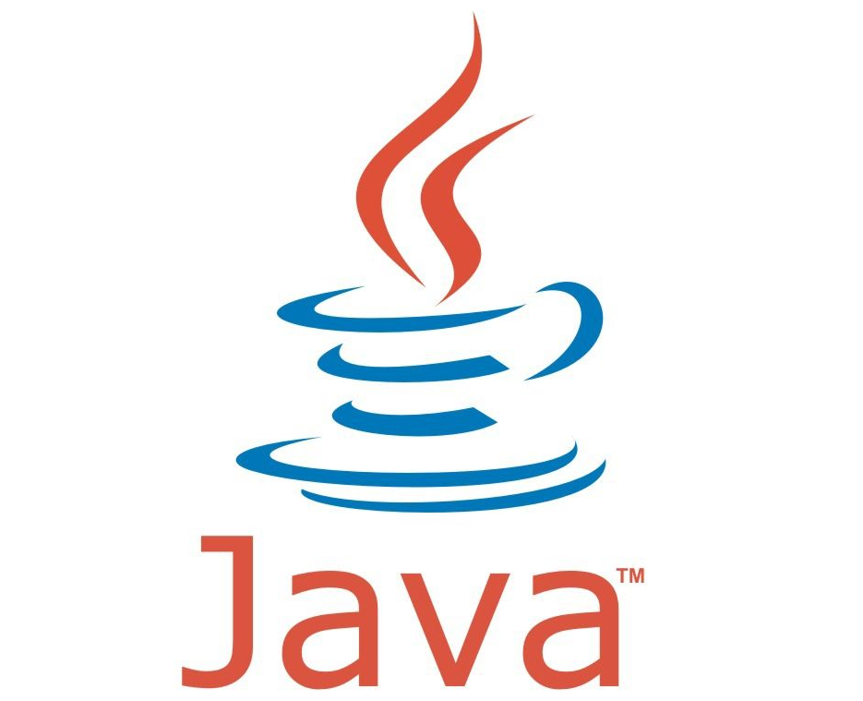
vs

Slide 6
What can kotlin do to me?
Less code combined with greater readability. Spend less time writing your code and working to understand the code of others.
Mature language and environment. Since its creation in 2011, Kotlin has developed continuously, not only as a language but as a whole ecosystem with robust tooling. Now it's seamlessly integrated in Android Studio and is actively used by many companies for developing Android applications.
Kotlin support in Android Jetpack and other libraries. KTX extensions add Kotlin language features, such as coroutines, extension functions, lambdas, and named parameters, to existing Android libraries.
Interoperability with Java. You can use Kotlin along with the Java programming language in your applications without needing to migrate all your code to Kotlin.
Support for multiplatform development. You can use Kotlin for developing not only Android but also iOS, backend, and web applications. Enjoy the benefits of sharing the common code among the platforms.
Code safety. Less code and better readability lead to fewer errors. The Kotlin compiler detects these remaining errors, making the code safe.
Easy learning. Kotlin is very easy to learn, especially for Java developers.
Big community. Kotlin has great support and many contributions from the community, which is growing all over the world. According to Google, over 60% of the top 1000 apps on the Play Store use Kotlin.

Slide 7
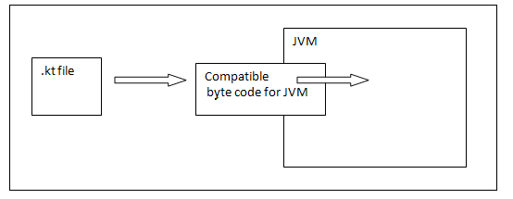
Kotlin Architecture
Kotlin is a programming language and has its own architecture to allocate memory and produce a quality output to the end user. Following are the different scenarios where Kotlin compiler will work differently, whenever it is targeting different other kind of languages such as Java and JavaScript.
Kotlin compiler creates a byte code and that byte code can run on the JVM, which is exactly equal to the byte code generated by the Java .class file. Whenever two byte coded file runs on the JVM, they can communicate with each other and this is how an interoperable feature is established in Kotlin for Java.

Slide 8
Kotlin Clean Architecture
This is an Android Clean Architecture base project using 100% Kotlin including Unit tests!
Benefit
Makes your new project clean
Isolates UI, business logic and data sources' responsibilities
Testable
Avoids multi-threading problems
Presentation
Domain
Data
Subscribe
Subscribe
View
(Activity or Fragment)
Use Case
(Business Logic)
Repository
Presenter
Remote API
Emit
Use Case
(Business Logic)
Emit
Observer
Local
Database

Slide 9
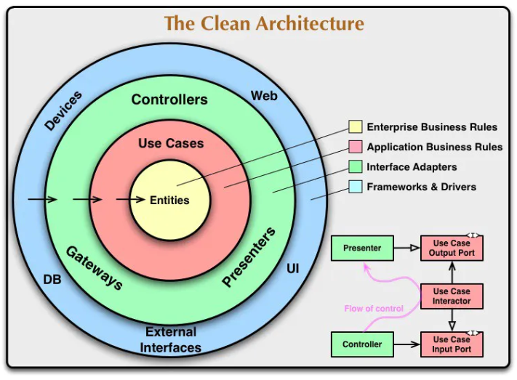

Slide 10

Thank you

